Slide 1
Mixed Numbers
Adding & Subtracting

Slide 2
Objective: I can add and subtract rational numbers (mixed numbers) by using rapid math. (7.NS.A.3)

Slide 3
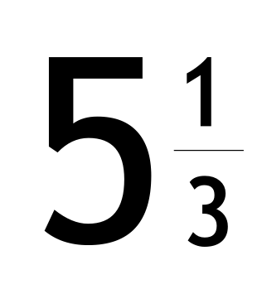
Mixed Number: A whole number and fraction
Vocabulary

Slide 4
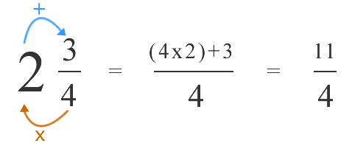
2 ¾
Example 1

Slide 5
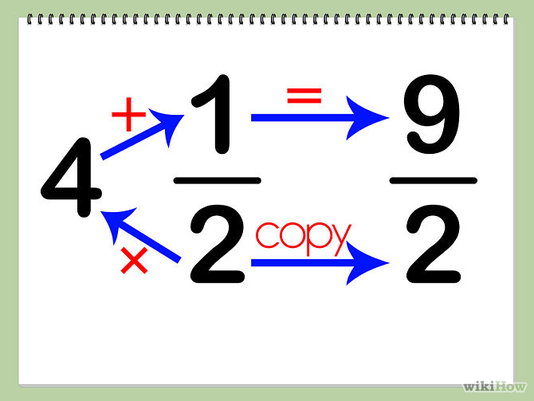
Example 2
4 ½ =

Slide 6
Try This ↓
1_2/3 + 3_1/3=
Quick Fire Challenge: Checking For Understanding

Slide 7
Try This ↓
4_2/5 – 2_4/9=
Quick Fire Challenge: Checking For Understanding

Slide 8
Try This ↓
5_1/2 + 2_1/8=
Quick Fire Challenge: Checking For Understanding

Slide 9
Exit Ticket
2_1/2 – 1_3/10

Slide 10
Calculator Tips
1.Enter the whole number then hit unit.
2. Enter the numerator, then the down arrow and enter the denominator.
3. Before hitting enter, look for the “A_b/c ↔ d/e” button, click it then, press enter.
Try This:
1_3/4, What is your answer?

