Slide 1
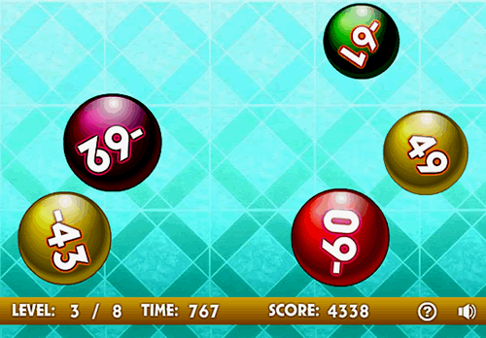
Multiplying and Dividing Integers

Slide 2
Objective:
I can use properties of operations to multiply and divide rational numbers (integers). (7.NS.A.2a)

Slide 3
Rules for Multiplying and Dividing Integers
Rule 1: The product of a positive integer and a negative integer is a negative integer.
(8)(-4)= -32 8÷(-4)= -2
Rule 2: The product of two negative integers or two positive integers is a positive integer.
(-9)(-3)= 27 (-9)÷(-3)= 3

Slide 4
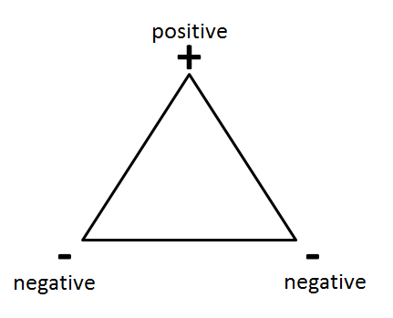
Integer Triangle

Slide 5
Multiplication Examples
(⁻2) (7) = ?
(3) X (⁻8) = ?
3) (5)(6) = ?

Slide 6
Remember that……
Positive ÷ Positive = Positive
Negative ÷ Negative = Positive
Negative ÷ Positive = Negative

Slide 7
Dividing Integers Examples
35÷(-7)=
-25÷(-5)=
6/(-3) =

Slide 8
INTEGERS CARD GAME

Slide 9
RULES & DIRECTIONS
RED—NEGATIVE K-13 Q-12 J-11 A-1
BLACK—POSITIVE
Deal the deck until you and your partner have the same number of cards.
Each player plays (places down) one card at a time.
Ms. King will spin the wheel. The wheel decides which operation to use.

