Slide 1
YESTERDAY’S RECAP

Slide 2
WANT A SEAT?

Slide 3
EXIT TICKET
Evaluate each expression.
|-16|
|12|
|-7| + |5|
10 - |-2|

Slide 4
YOUR TURN….
Pg. 79
Num. 11-14 & 25-33
*Write questions and answers☺

Slide 5
Adding Integers

Slide 6
Objective:
I can use properties of operations to add rational numbers.
(7.NS.A.1d)

Slide 7
Vocabulary:
-Rational Number: Numbers that can be written as the ratio of two integers in which the denominator is not zero.

Slide 8
What are rational numbers?
Characteristics of rational numbers:
-integers
-fractions
-mixed numbers
-percents
Examples:

Slide 9
WATCH THIS….

Slide 10
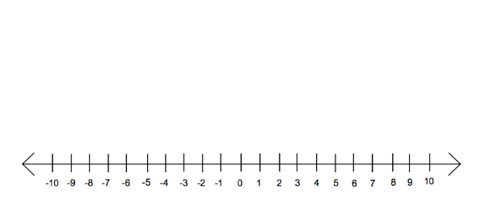
(-3) + (5)

Slide 11
(–10) + (2)

Slide 12
HERE WE GO…

Slide 13
The Rules:
If the numbers have the same signs, add them and keep that sign.
2. If they have opposite signs, subtract and take the sign of the number with the larger absolute value.

Slide 14
Remember this….
(+) + (+) = ADD & answer is positive
7 + 3 = 10
(-) + (-) = ADD & answer is negative
-7 + -3 = -10
(+) + (-)
7 + -3 = 4
(-) + (+)
-7 + 3 = -4
= SUBTRACT & take sign of the larger absolute value

Slide 15
EXAMPLE 1:
Evaluate (7) + (-2) =

Slide 16
EXAMPLE 2:
Evaluate (5) + (-9) =

Slide 17
EXAMPLE 3:
Evaluate (–2) + (-7) =

Slide 18
EXAMPLE 4:
Evaluate (-9) + (2) =

Slide 19
https://www.brainpop.com/math/numbersandoperations/addingandsubtractingintegers/

Slide 20
FINISH BEACH TOWEL INDEPENDENTLY!!
THOSE WHO ARE FINISHED YOU WILL BE WORKING ON TEST PREP MATH PROBLEMS USING WHITE BOARDS INDEPENTLY.

Slide 21
WHITE BOARD QUICK FIRE

Slide 22
(-2) + (-7)

Slide 23
0+ (-4)

Slide 24
(-5) + (-5)

Slide 25
(-2) + (-3)

Slide 26
(-2) + 4

Slide 27
2 + (-6)

Slide 28
7+ 1

Slide 29
(-2) + (-9)

Slide 30
CLASSWORK
PG. 87
NUM. 1 – 12
Show work by using number lines or drawing counter chips.

Slide 31
ADDING INTEGERS CARD GAME

Slide 32
RULES & DIRECTIONS
RED—NEGATIVE K-13 Q-12 J-11 A-1
BLACK—POSITIVE
Deal the deck until you and your partner have the same number of cards.
Each player plays (places down) one card at a time.
Whoever answers the “card problem” first and is correct wins those cards.
Keep playing until one player has ALL the cards. ☺

Slide 33
NUMBER TALK

Slide 34
55 - 21

